Slide 1
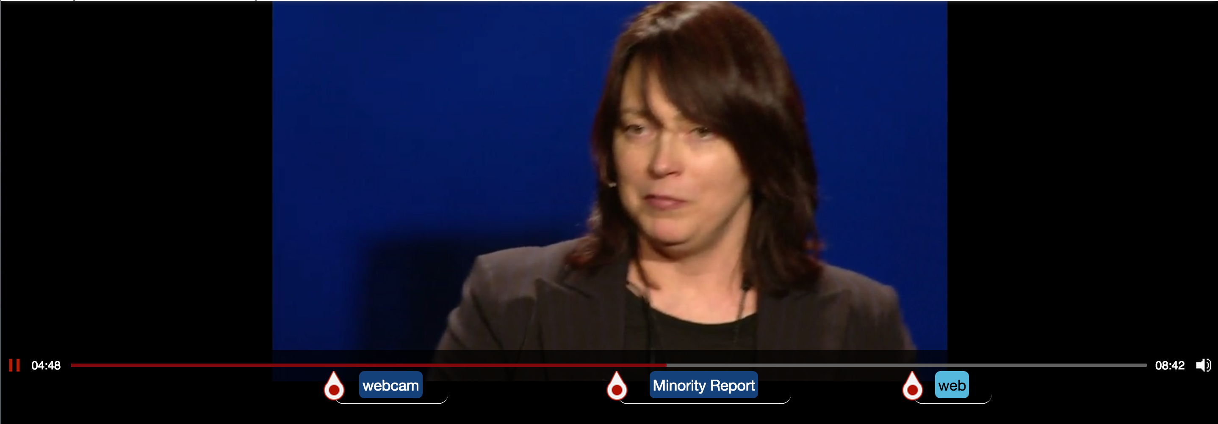
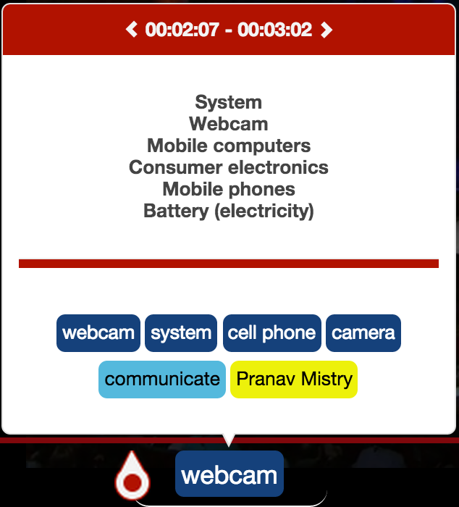
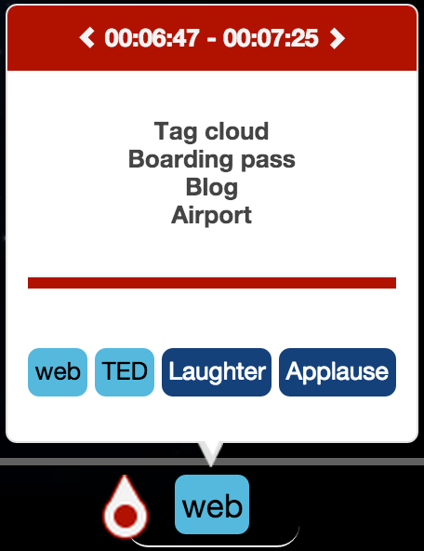




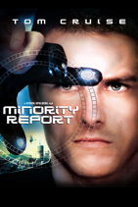

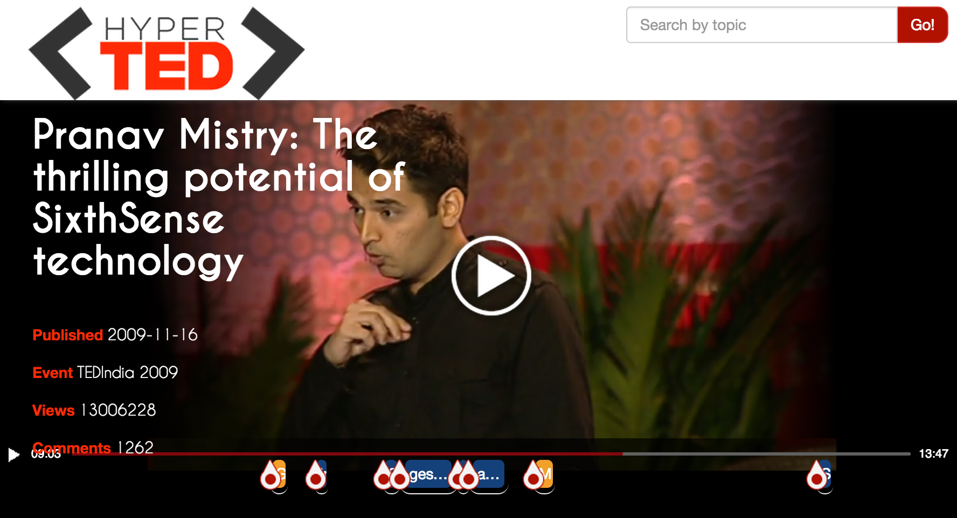

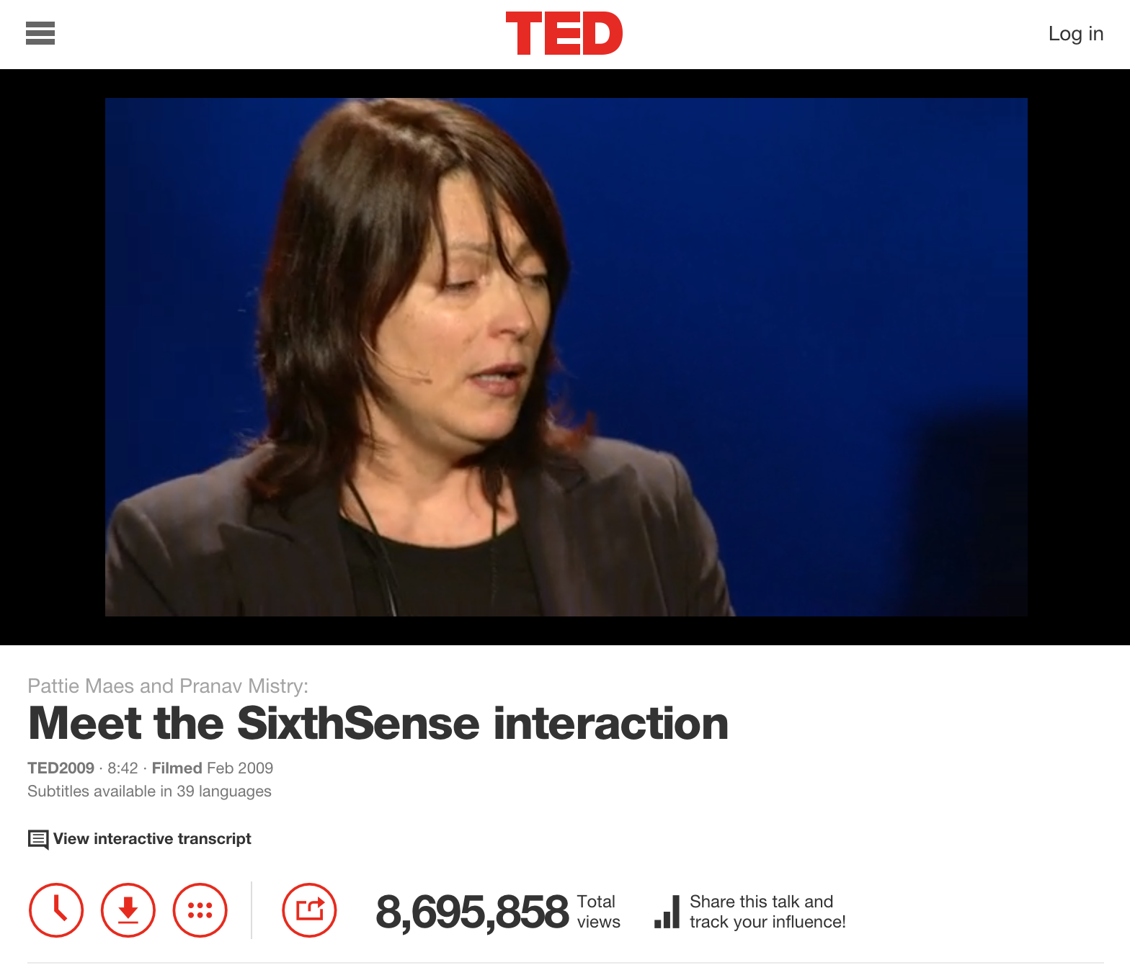




2014
Hot spots
Chapters
Entities
Related Ted’s Chapters
2006
.com
Courses
1984
Understanding environment:
A system approach
The Mysterious Field of Engineering Systems
Systems practice: Managing sustainability

